Slide 1
Baker Creek Driving Data Preparation Methodology
By Haley Brauner

Slide 2
Air Pressure
Compared Vital, Yellowkinfe A, and GEM @ Vital datasets
Yellowknife is consistently greater than the other 2 locations
Vital and GEM @ Vital match almost perfectly except that in 2009, Vital is shifted forward by 6 days (shifting back 6 days matches almost perfectly
Combining methodology:
Used Vital data primarily, with the 2009 observations shifted back in time by 6 days
Gap-filled with GEM @ Vital data
The following 2 slides show a comparison of the original and shifted data, followed by the 2012-2018 data and the a close-up of just 2009 (shifted)

Slide 3
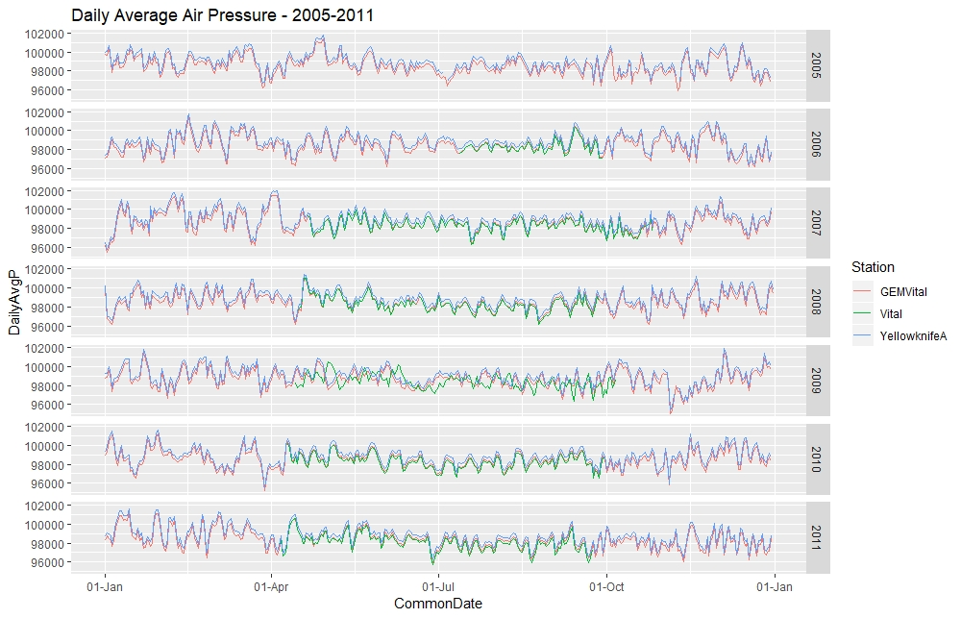
Notes:
Vital matches closely with GEMVital (where present)
Note the 6-day shift in 2009

Slide 4
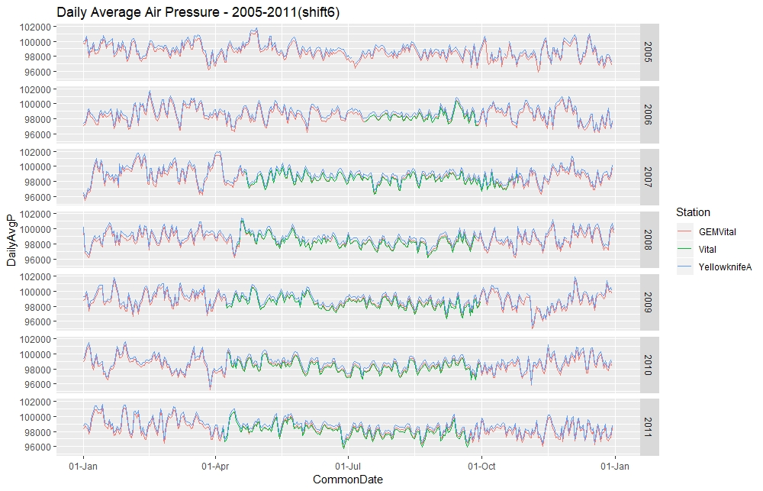
Notes:
- Shifting the 2009 data by 6 days makes the data match up nearly perfectly

Slide 5
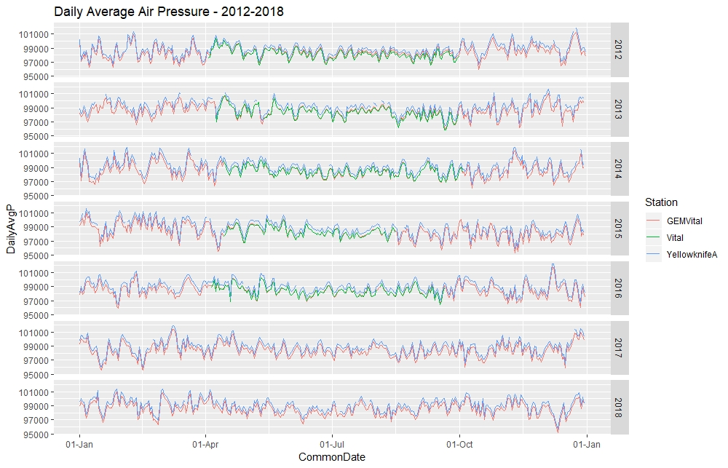

Slide 6
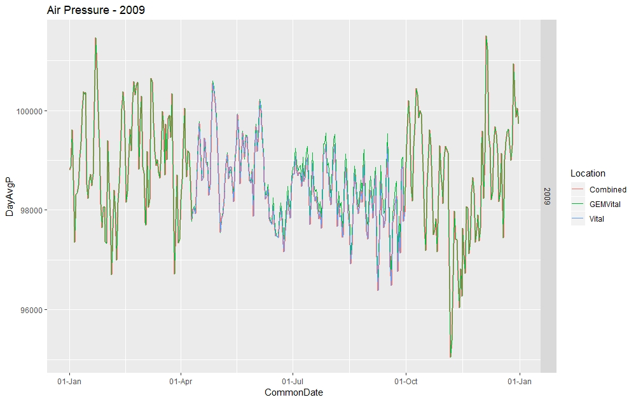
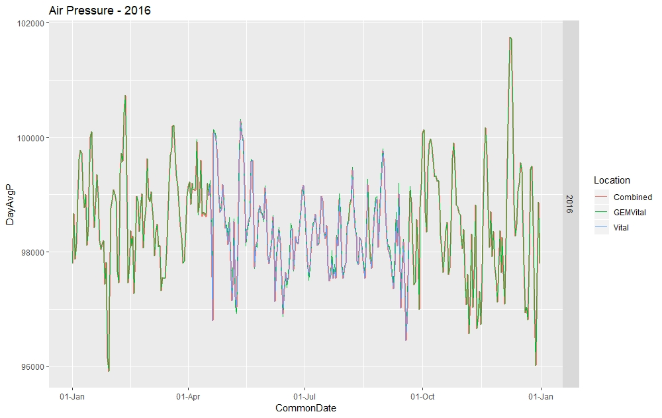

Slide 7
Air Temperature
Combining methodology:
A dry adiabatic lapse rate of 6.5ºC/km was used to scale the Vital observations at 2.8 m (incorrectly labelled as 1.1m) and 4.4m, and Yellowknife A (2 m) up to 40 m
The shift in 2009 Vital data was also present and was shifted back by 6 days to match
Vital at 4.4 m was used as the primary dataset, then gap-filled with Vital at 2.8 m, followed by Yellowknife then GEM data
The following slides show a comparison of the datasets for 2005-2011, including before and after the shift in Vital data

Slide 8
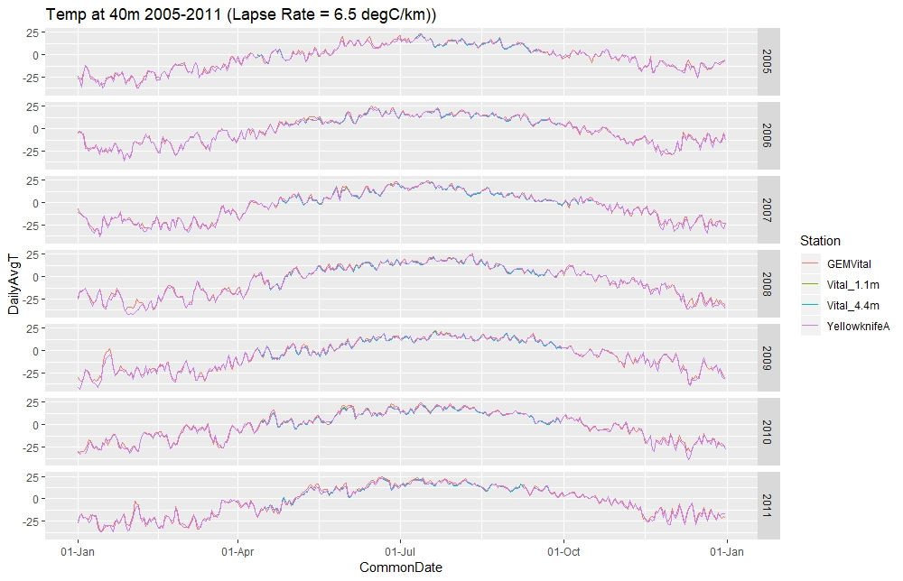

Slide 9
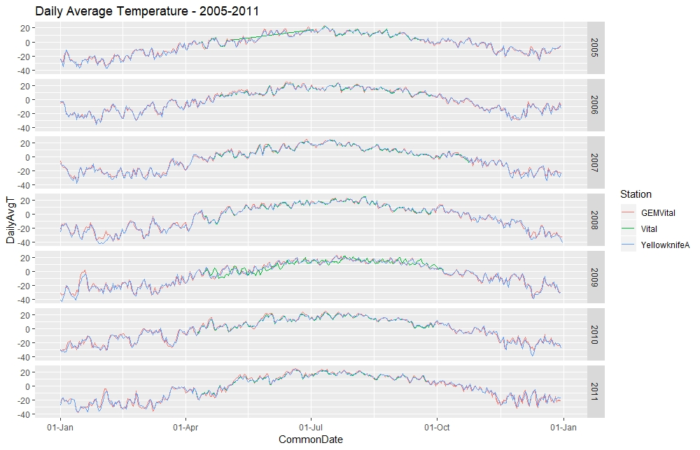
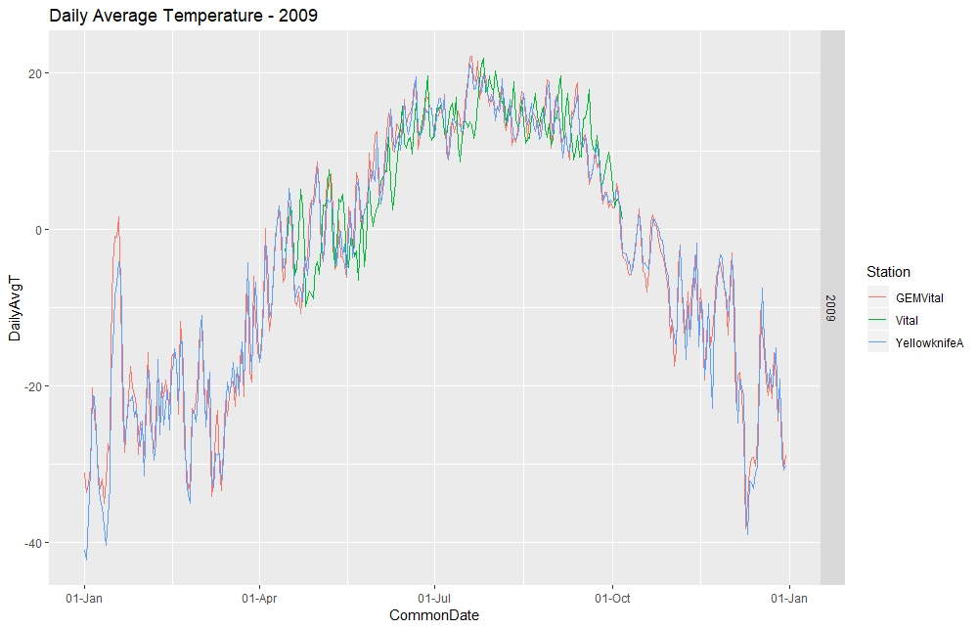

Slide 10
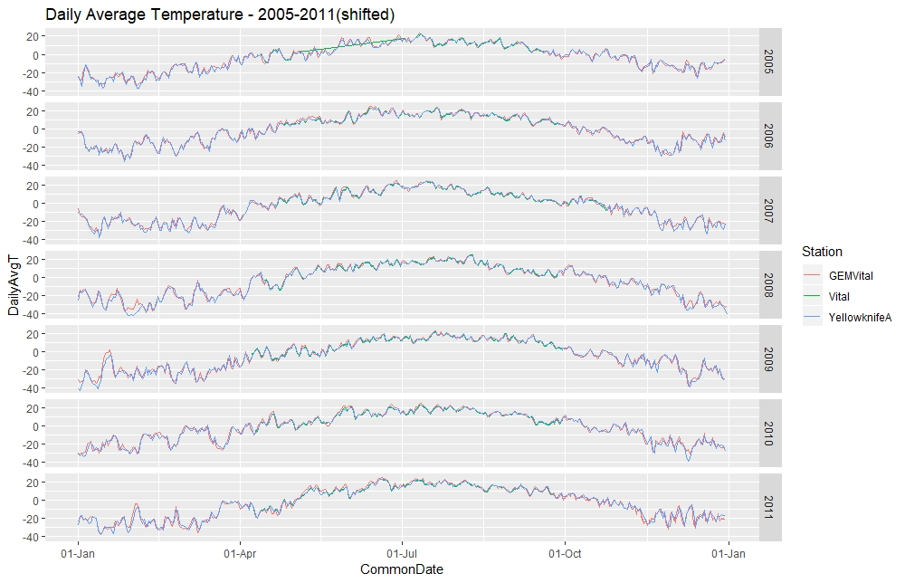
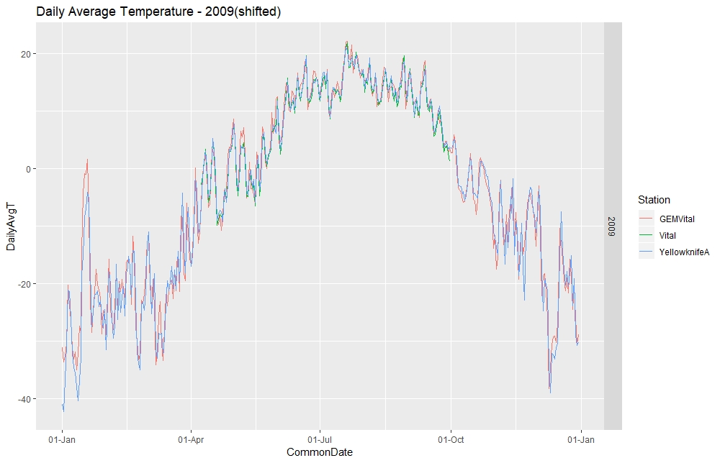

Slide 11
Incoming Shortwave Radiation
When comparing the data, noticed a magnitude shift upward in the Vital data starting around June 21, 2008
Noticed that in 2009, the Vital data seems to be shifted forward by 3 days (not 6 like the other variables)
In 2016, daily average values look to be too high at the Vital station
Combining methodology
Vital was used as the primary, but omitted 2008 from June 20 to the end of the year, 2016 prior to April 17, and shifted 2009 back by 3 days
Gap-filled with Landing data
Gap-filled remaining with GEM @ Vital was used to gap-fill
Negative values were later converted to zero in Excel prior to being used in the model

Slide 12
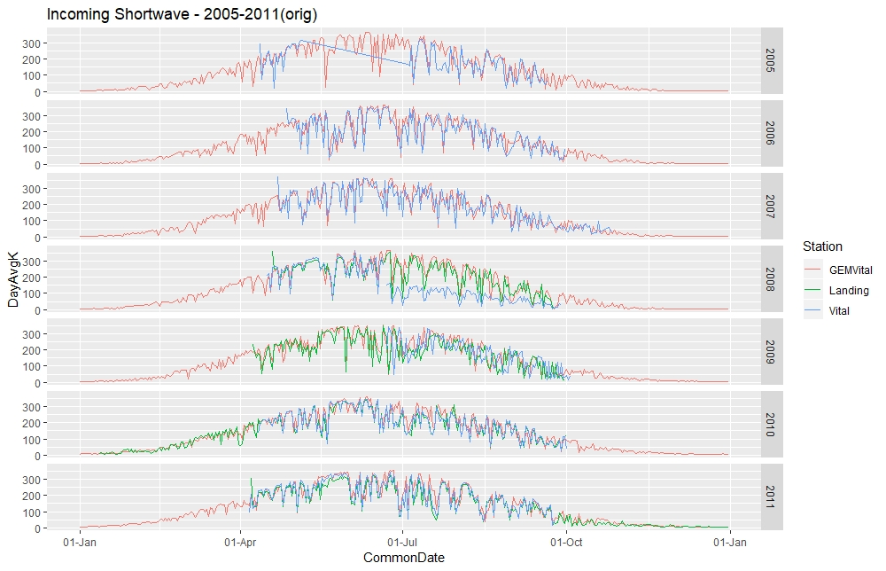

Slide 13
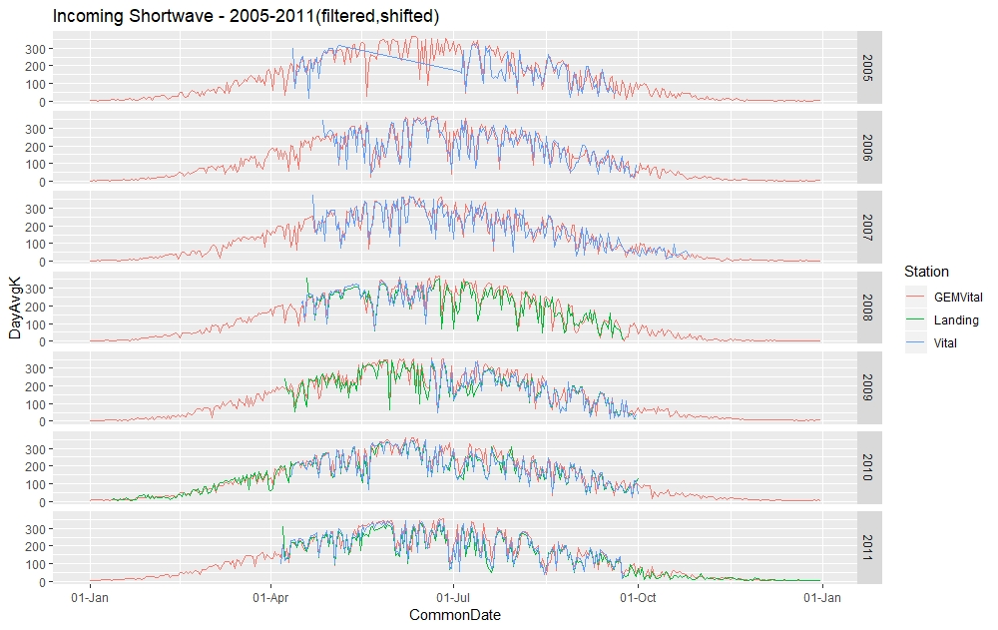

Slide 14
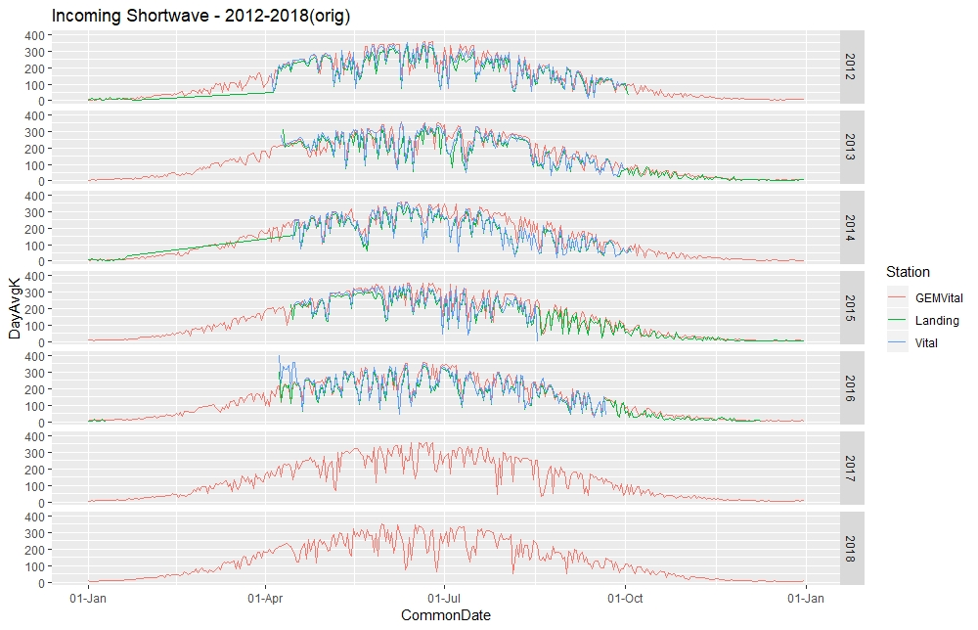

Slide 15
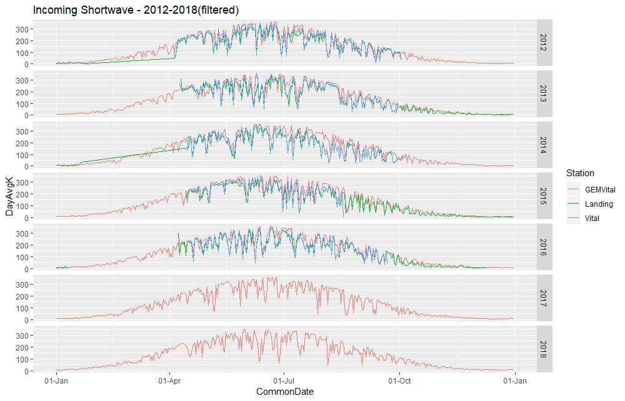

Slide 16
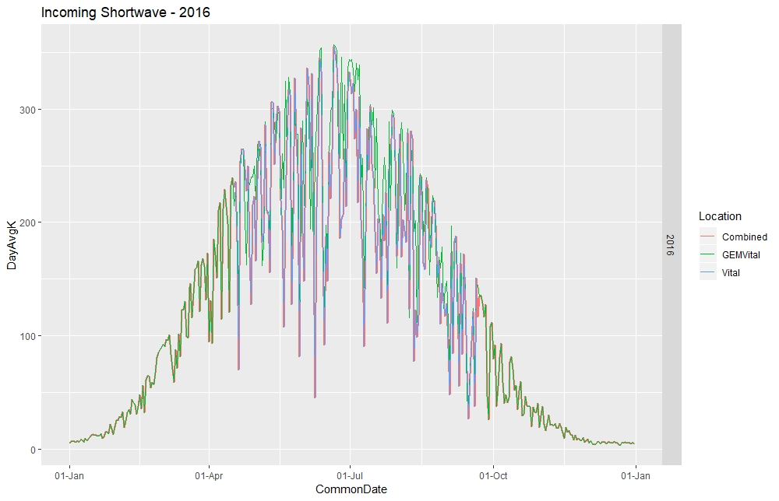

Slide 17
Incoming Longwave Radiation
Compared GEM and Vital data
In 2005, there were minimal Vital observations
In 2008, the June and July data was shifted upward, and a fair number of large negative values in July
The 2009 Vital data appeared to be shifted forward by 3 days
Combining Methodology:
Used Vital as primary data but filtered out June 20, 2008 onward and shifted 2009 back by 3 days
Gap-filled with GEM data

Slide 18
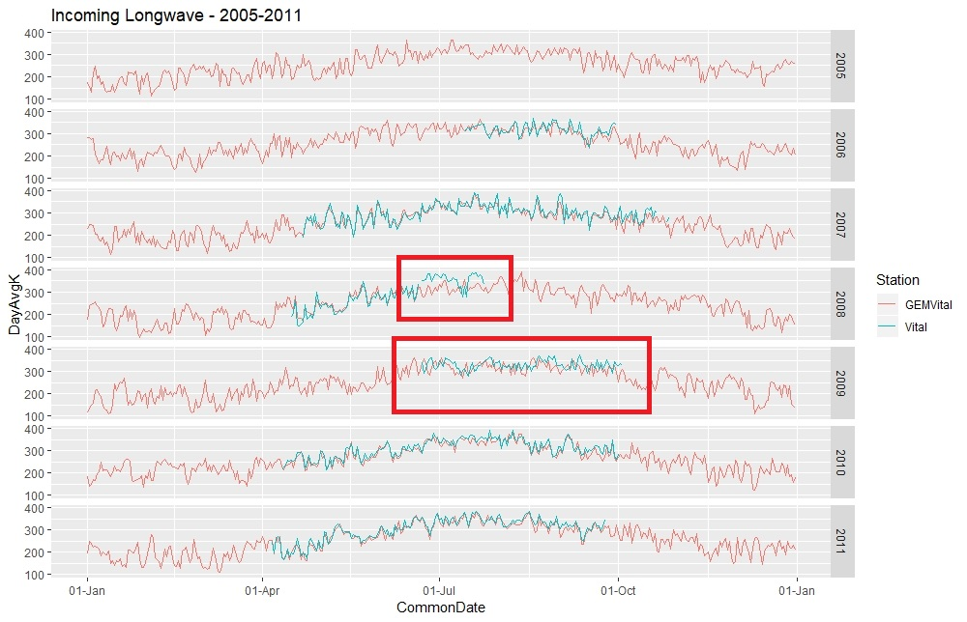

Slide 19
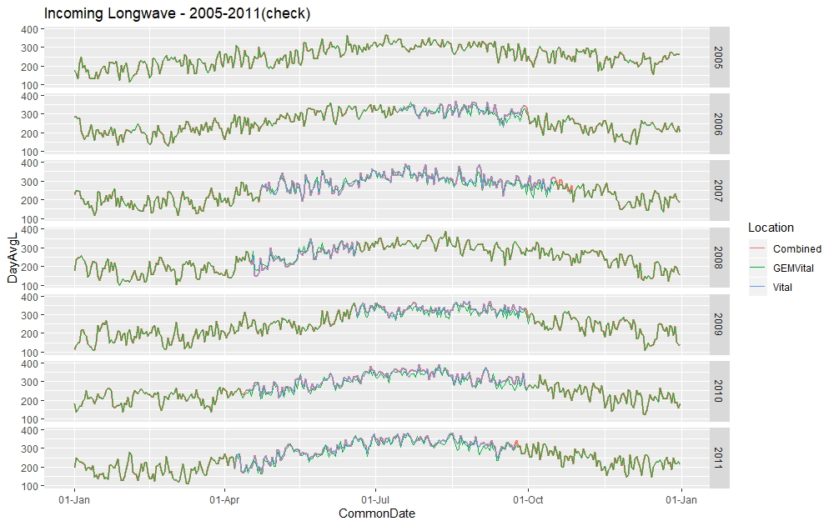

Slide 20
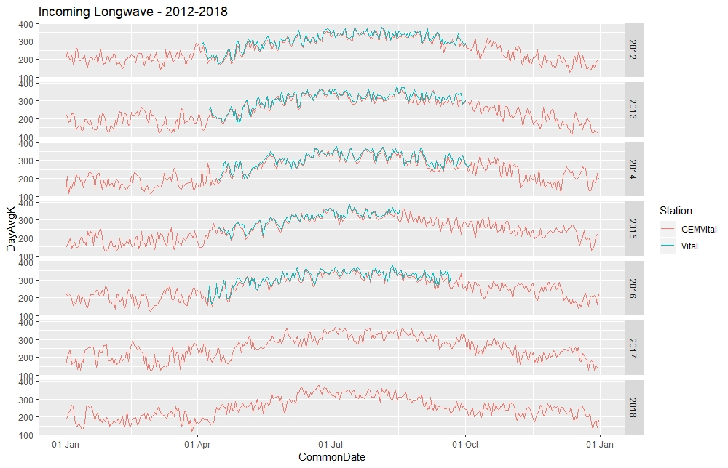

Slide 21
Humidity
During the summer months, GEM @ 2m ≅ GEM @ 40 m < Vital (both 2.8 m and 4.4 m), < Yellowknife < Landing
Since the Landing tower is at a lake, humidity is expected to be higher
In the winter, Yellowknife q is approximately equal to the GEM data
Tried scaling Vital and Yellowknife summer observations up to 40 m by using the T@40m instead of T near ground; didn’t make much of a difference
Combining Methodology:
Used the observed values from Vital @ 4.4 m as the primary (knowing that in the summer, the values are likely biased low.
Gap-filled with GEM (@40m) data

Slide 22
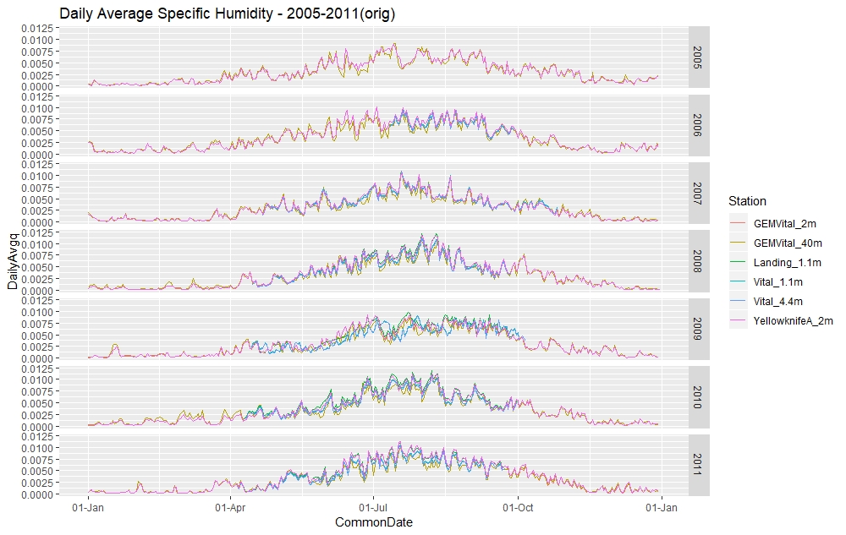

Slide 23
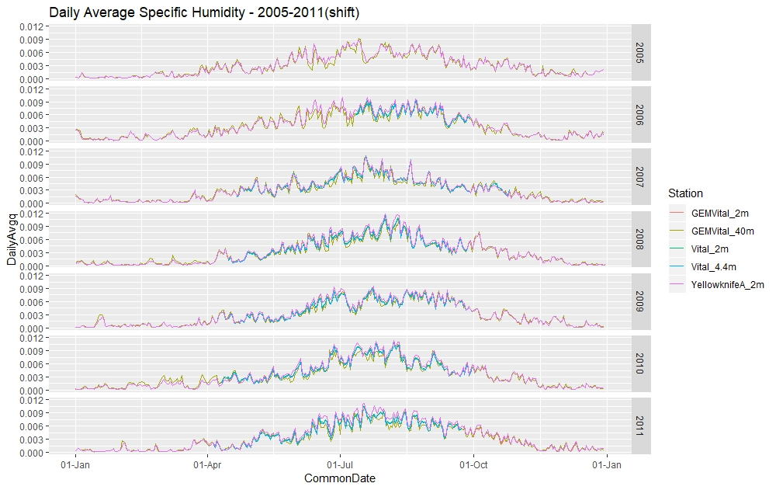

Slide 24
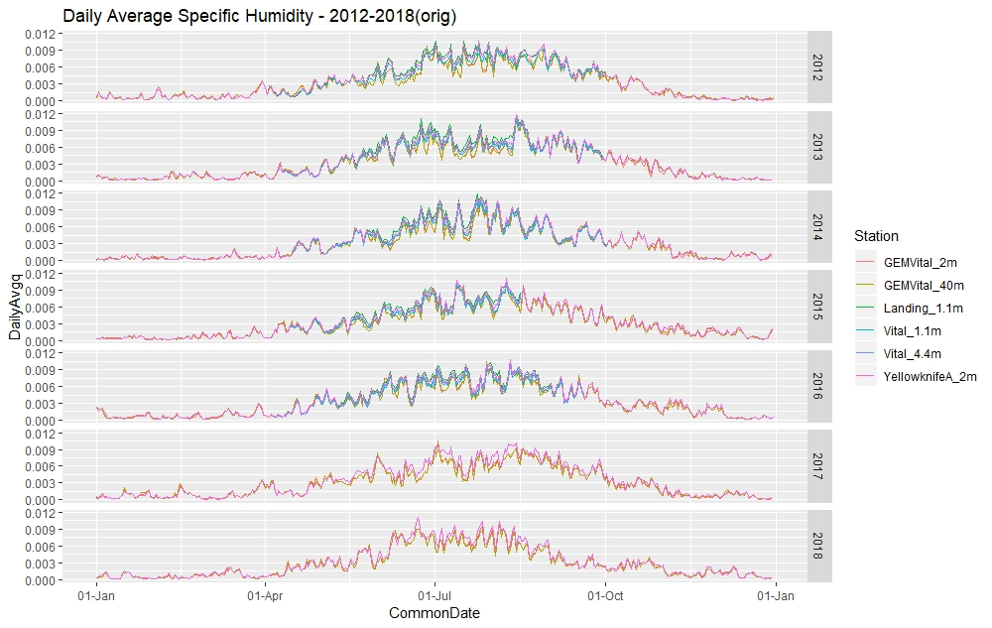

Slide 25
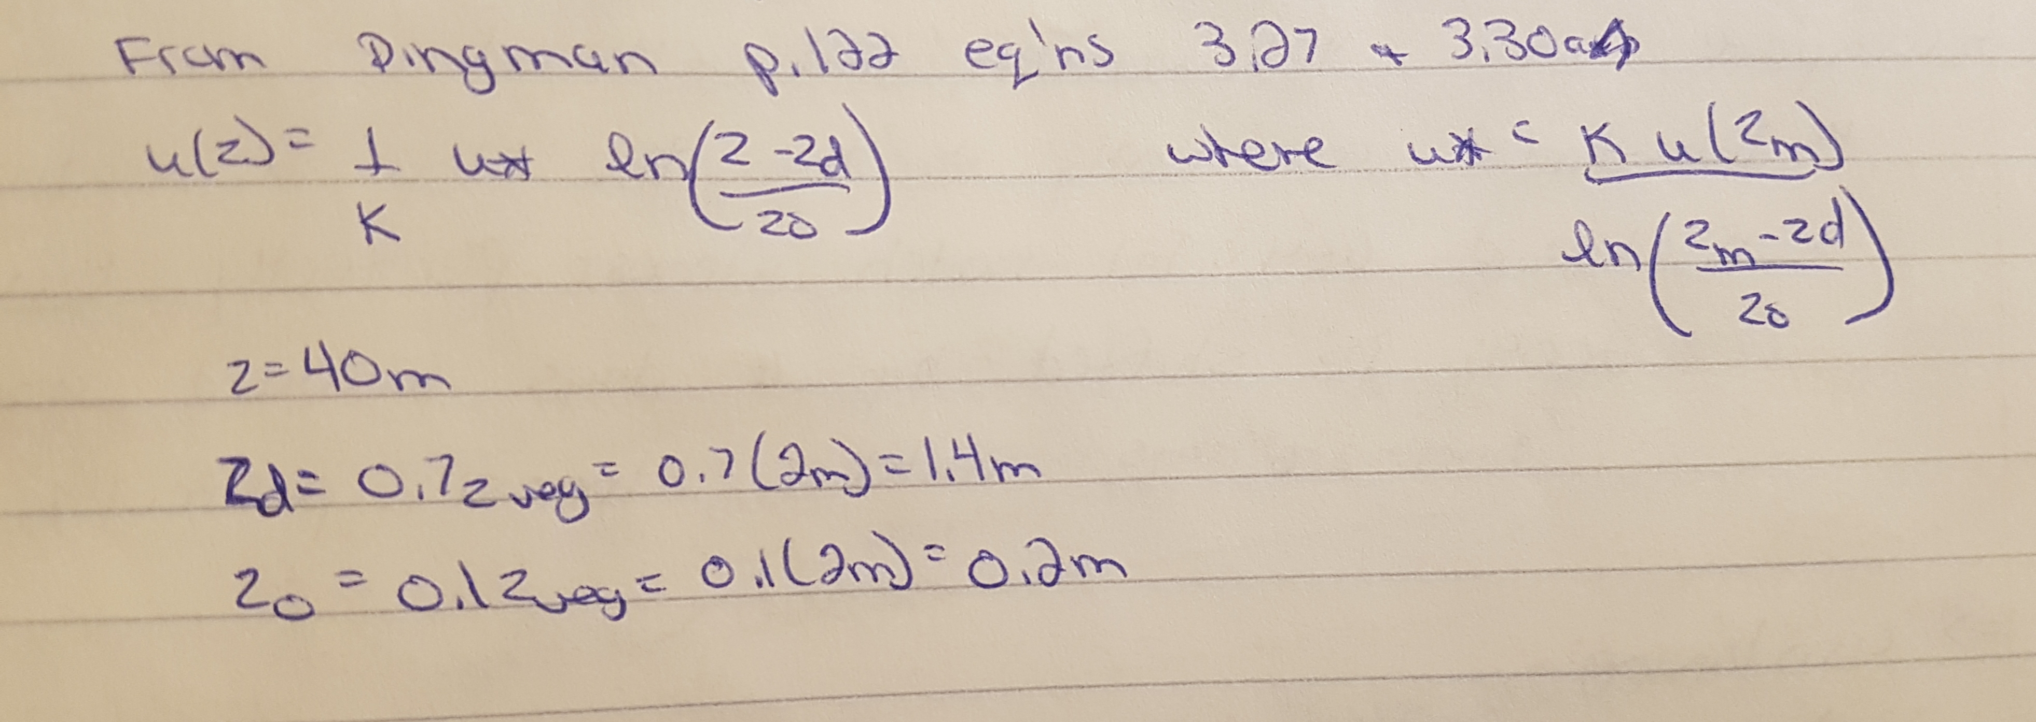
Wind Speed
Scaled wind speed up to 40 m using equations 3.27 and 3.30 a and b
Observations of Vital match reasonably well with GEM @ 40m, and Yellowknife seems to be lower. Could be due to rain interference or lower sensitivity instrument, but also there were many zero values in the hourly data. Therefore, Yellowknife not used
Combining Methodology
Used scaled Vital with 2009 shifted back 6 days as the primary
Used GEM @ 40 m (Vital) to gap-fill

Slide 26
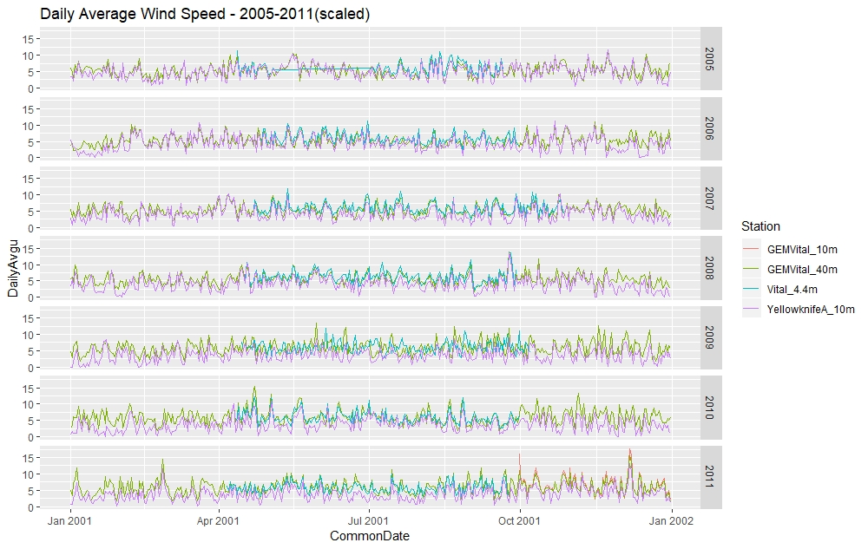

Slide 27
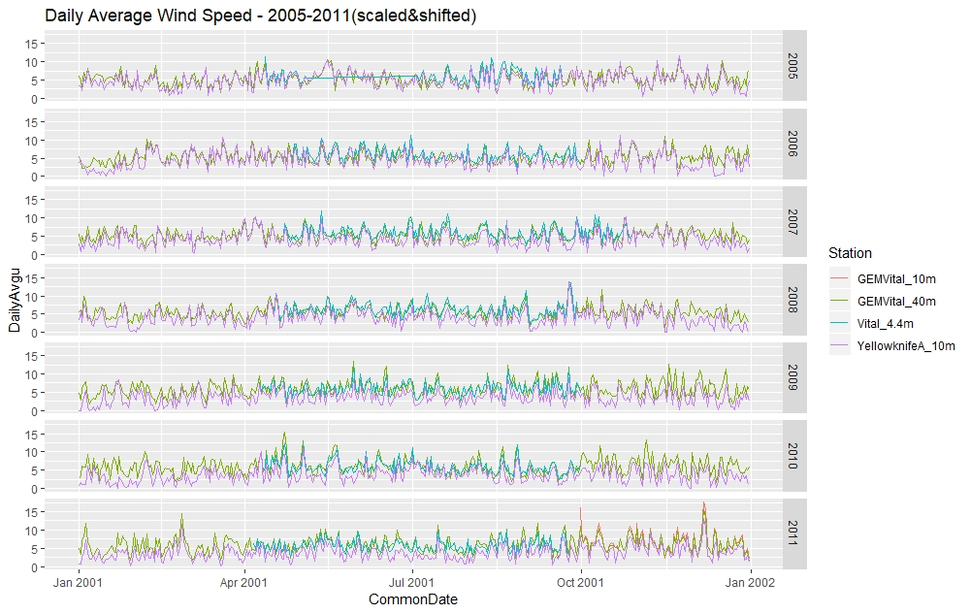

Slide 28
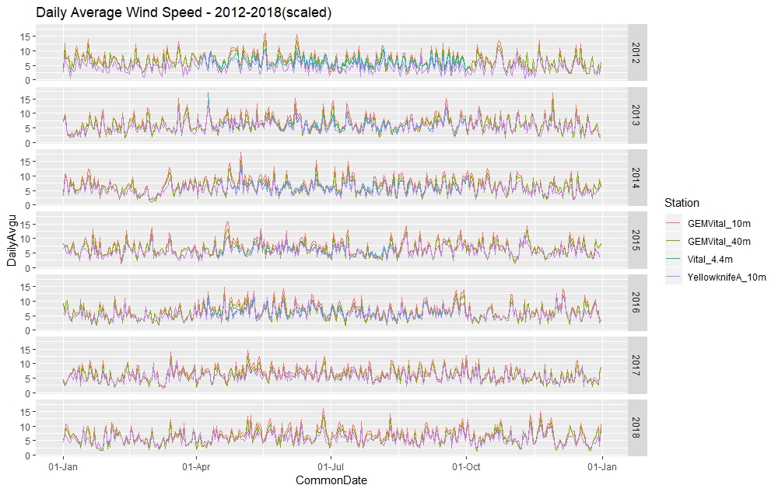

Slide 29
Precipitation
Combining methodology:
Used Vital as primary (shifted 2009 back by 6 days again)
Gap-filled with CaPA @ the Vital location
Note that looking at the annual cumulative bar graph (3 slides ahead), sometimes the combined precip is greater than CaPA, and sometimes less; this is due to the differences between the observed Vital data and the CaPA dataset

Slide 30
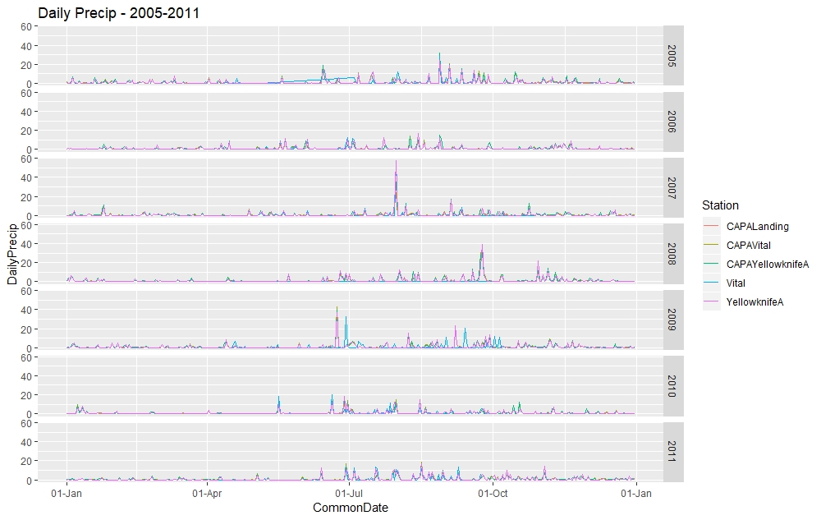

Slide 31
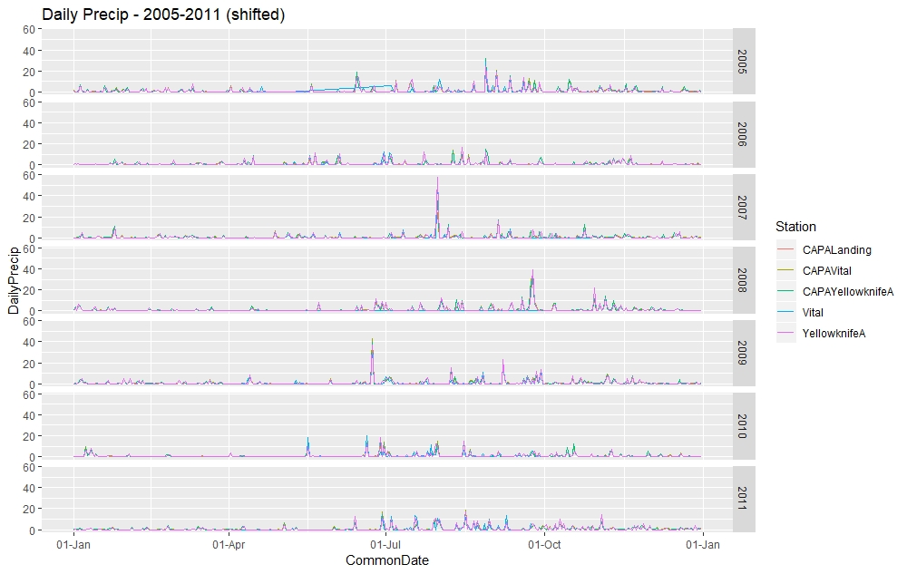

Slide 32
